Slide 1

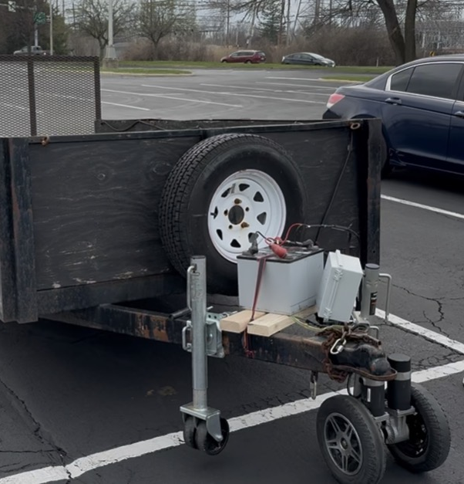
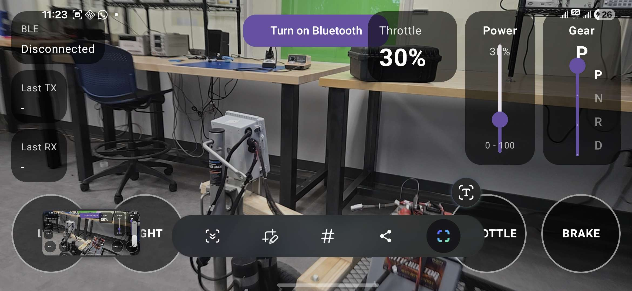
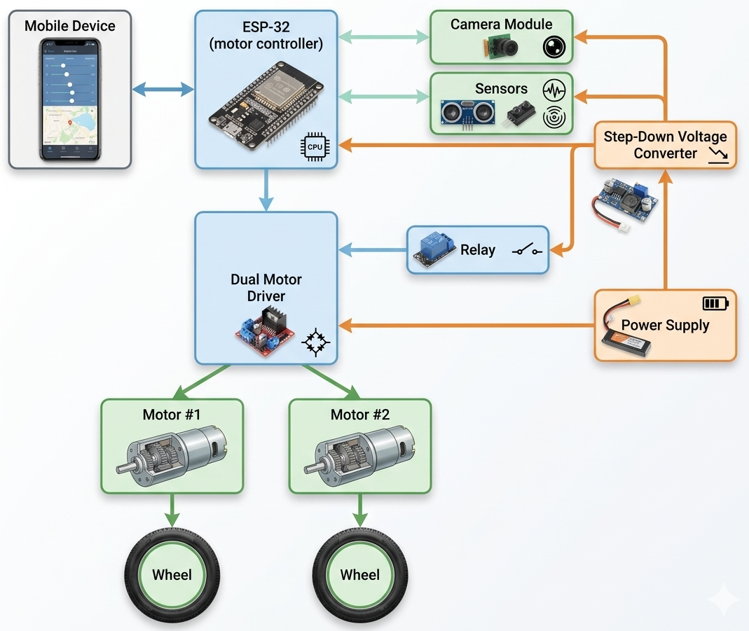
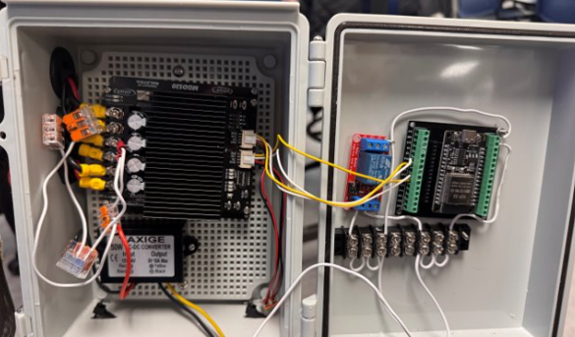

RC Trailer Jack
Mark Halter, Jacob Thaxton, Shubh Shahra, Kanisha
Department of Electrical Engineering and Computer Science
Overview
Engineering Targets
Results
Description: Our project addresses the frustration of parking, positioning, and hitching a trailer by replacing the manual labor of trailer positioning with a motorized jack system controlled wirelessly by the user on their smartphone.
Problem: Trailer owners often struggle with manual parking, positioning, and connecting to their trailers.
Solution: Construct a remotely controlled, electronically driven trailer jack to reduce the physical labor of moving a trailer.
Group Leader: Mark Halter
Hardware Team: Mark Halter & Jacob Thaxton
Software Team: Shubh Shahra & Kanisha
Continuous duty cycle of 10mins
Power Requirement = 12 V
Wireless control range of ≥ 30ft
Rate Tongue Load = 500 lb
Movement Speed = 1 mph
Software
Android app for wireless trailer control
BLE communication with ESP32
Real-time steering, throttle, brake, and gear input
Command packet transmission for motor control
Camera-assisted user interface for maneuvering
Adjustable throttle with gradual acceleration logic
Live connection and TX/RX feedback
Safety stop on brake or signal loss
Figure 2. RC Jack on Trailer
The RC Jack being tested on a full-scale trailer
Design
Future Improvements
Batteries act as power supply for most components
Step-Down Voltage Converter lowers the voltage to match the power requirements of the ESP-32
User commands their desired direction and speed in the mobile app
Mobile device and ESP-32 communicate over Bluetooth
ESP-32 controls the motor driver to generate the user’s commanded movement
Camera provides the user with a rearview feed
Self-Parking
Automated set-up for hitching
Compatibility with multiple trailer styles
Reduce size and/or improve placement of motors
References
1. Cytron Technologies. (n.d.). SmartDriveDuo Arduino examples. GitHub. https://github.com/CytronTechnologies/Cytron_SmartDriveDuo/tree/master/examples
Hardware
h
Cytron SmartDriveDuo MDDS30
Haul-Master 1000lb. Swing-Away Trailer Jack
8.7"x6.7"x4.3" Junction Box
ESP-WROOM-32 w/Breakout Board Shield Terminal Adapter
CIM CM808-029F/E 24VDC Geared Motors
Acknowledgements
Project Advisor: Dr. Daniel Georgiev
Senior Design Professor: Dr. Ashish Kharel
Teaching Assistant: Mehzabien Iqbal

